Slide 1

Project: G2M Insight For Cab Investment Firm Data Science Virtual Internship
Submitted by : Siddharth Mahindru
Date : 19-July-2022

Slide 2







Approach
Understanding Bussiness Problem
EDA Results
Understanding Datasets Provided
Recommendation
Bivariate And Multivariate Analysis
Hypothesis Testing
Profit Analysis

Slide 3
Understanding Bussiness Problem
EDA

Slide 4

XYZ is a private firm in US. XYZ wants to invest in US Cab Company. US has 2 major cab companies - Pink Cab and Yellow Cab. We must find out which Cab company would be good choice to invest in for XYZ company. For this purpose, we will mostly focus on profitable cab company. Whichever cab company seems suitable in terms on market value, we would invest in that.
Bussiness Problem

Slide 5
Understanding
Datasets Provided
EDA

Slide 6
Cab_Data.csv – this data file includes the details of transactions for 2 cab companies
Customer_ID.csv – this file contains the information about customer’s demographics.
Transaction_ID.csv – this is a mapping table that contains transaction to customer mapping and mode of payment.
City.csv – this data file contains an information about US cities, their population, and the number of cab users All These datasets were merged, to form the final dataset for performing EDA.
Information About the Datasets Provided

Slide 7
Performing Bivariate And Multivariate Analysis to find out Meaning-full Insights
EDA

Slide 8
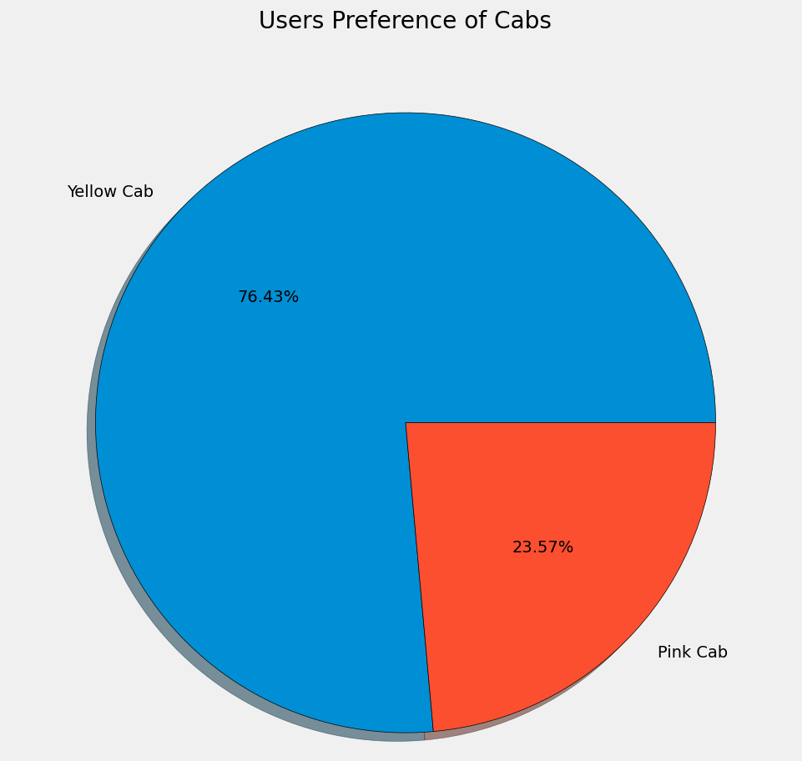
Most Users prefer to use Yellow Cab Than Pink Cab
Which Company has more Users?

Slide 9
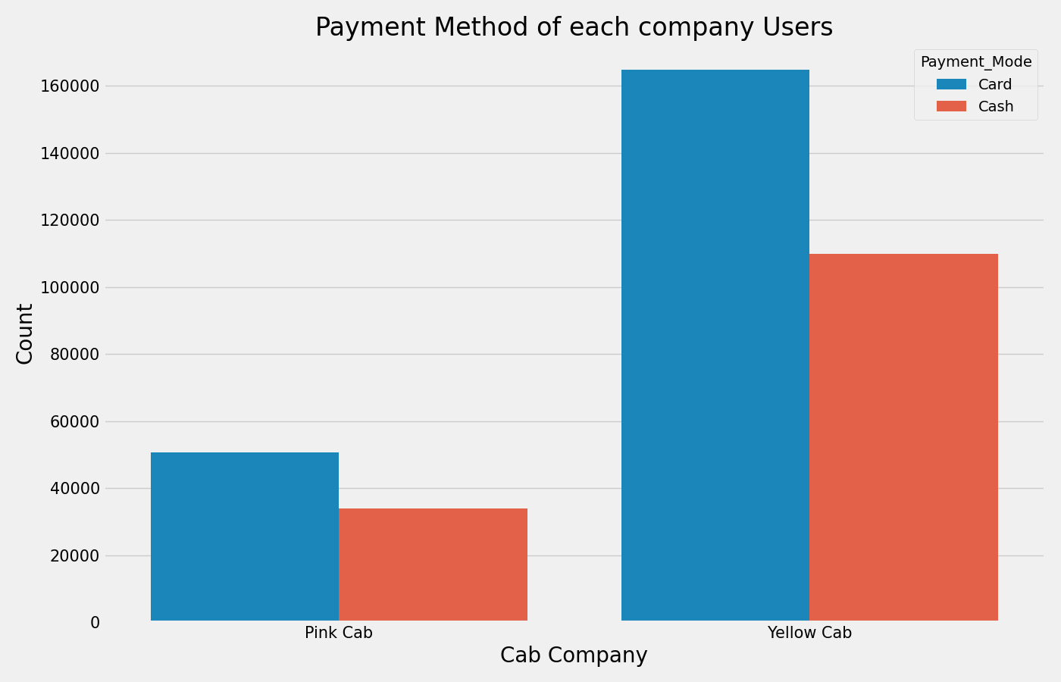
Most users prefer to pay by Card than Cash
Payment Method of Each Company Users

Slide 10
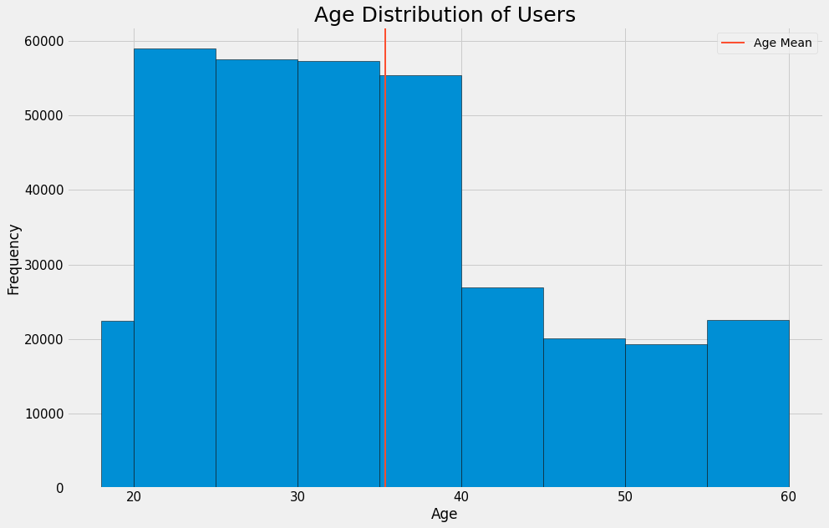
This graph shows that Most of the Users were in between age 20 to 40.
Age Distribution of Users

Slide 11
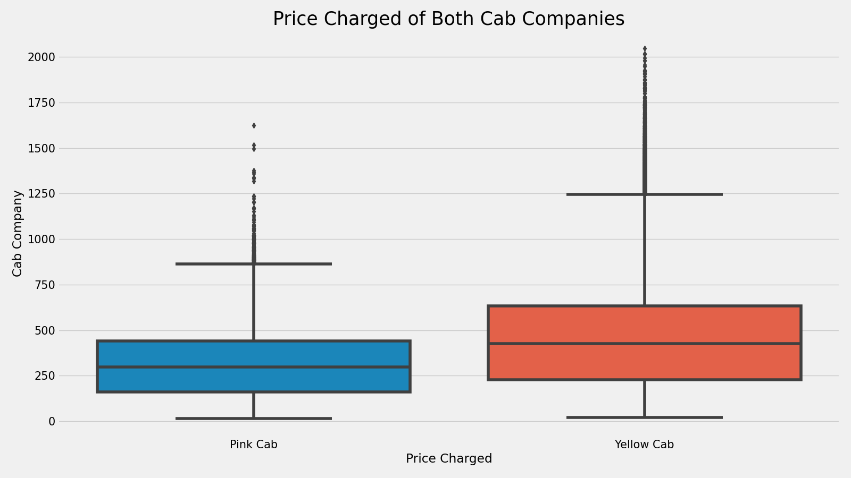
This graph shows that the price charged by Yellow cab is comparatively more than Pink Cab.
Price Charged for Both Cab Companies

Slide 12
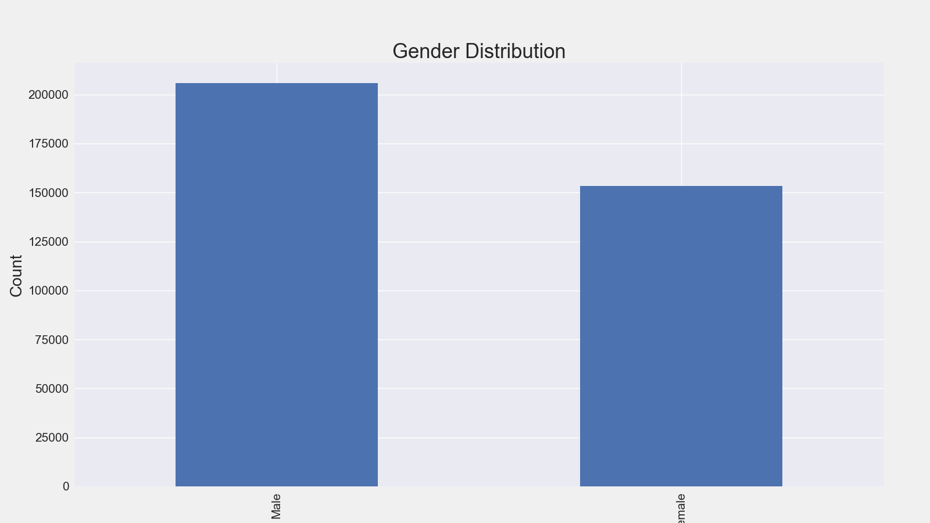
This graph shows that the Male users prefer to travel by cab more.
Gender Distribution

Slide 13
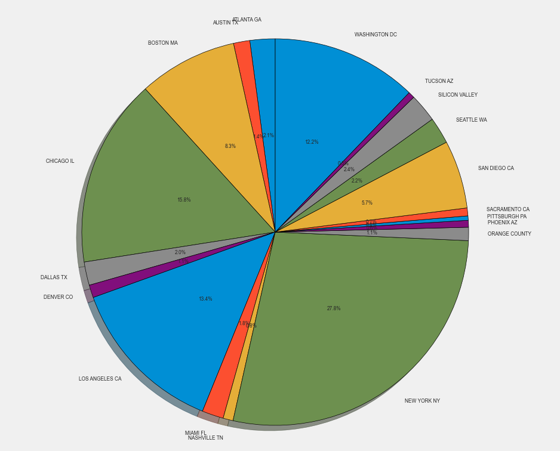
This pie chart shows that New York City has the highest Cab users with 27% followed by Chicago with 16% and Los Angeles with 13%.
Users Per City

Slide 14
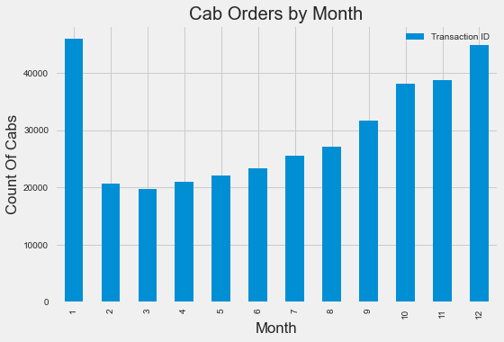
This graph shows that the Cab was ordered the most in the month of January and December
Cab Orders per Month

Slide 15
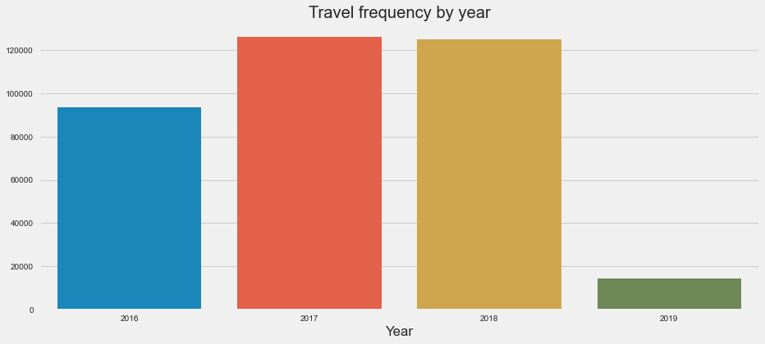
This graph shows that the travel by cab was more in 2017 and 2018.
Travel frequency by year

Slide 16
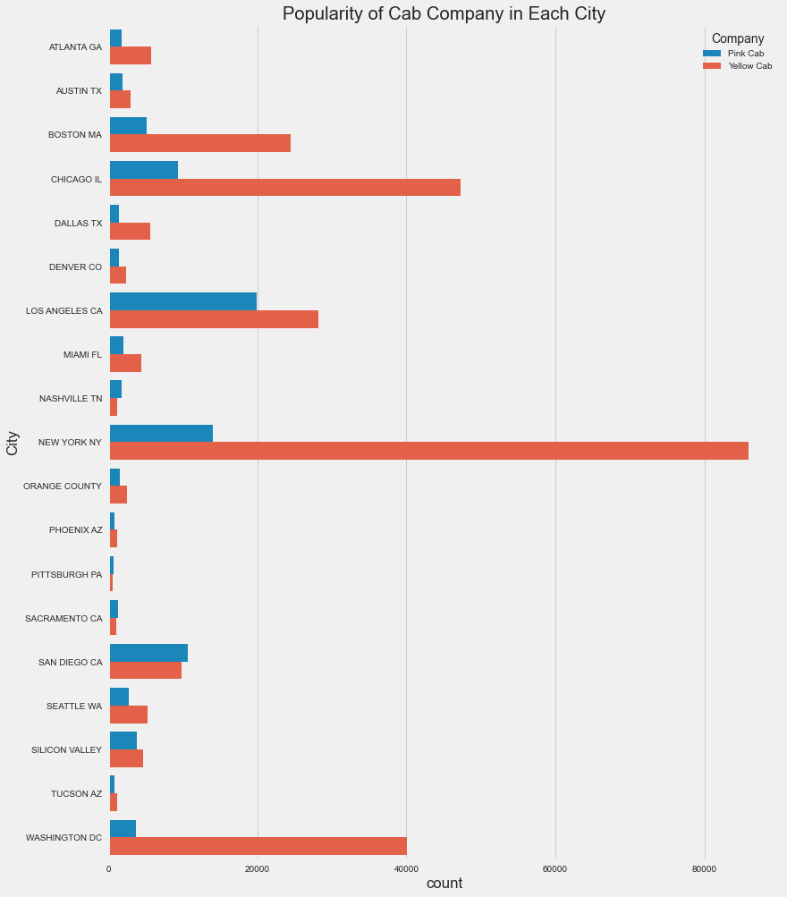
This Graph shows that Yellow Cab is more popular 15 countries including Washington DC, New York NY, Chicago IL, Boston MA. However, Pink Cab is more popular in San Diego CA, Sacramento CA and Nashville TN.
Popularity of Cab Company in Each City

Slide 17
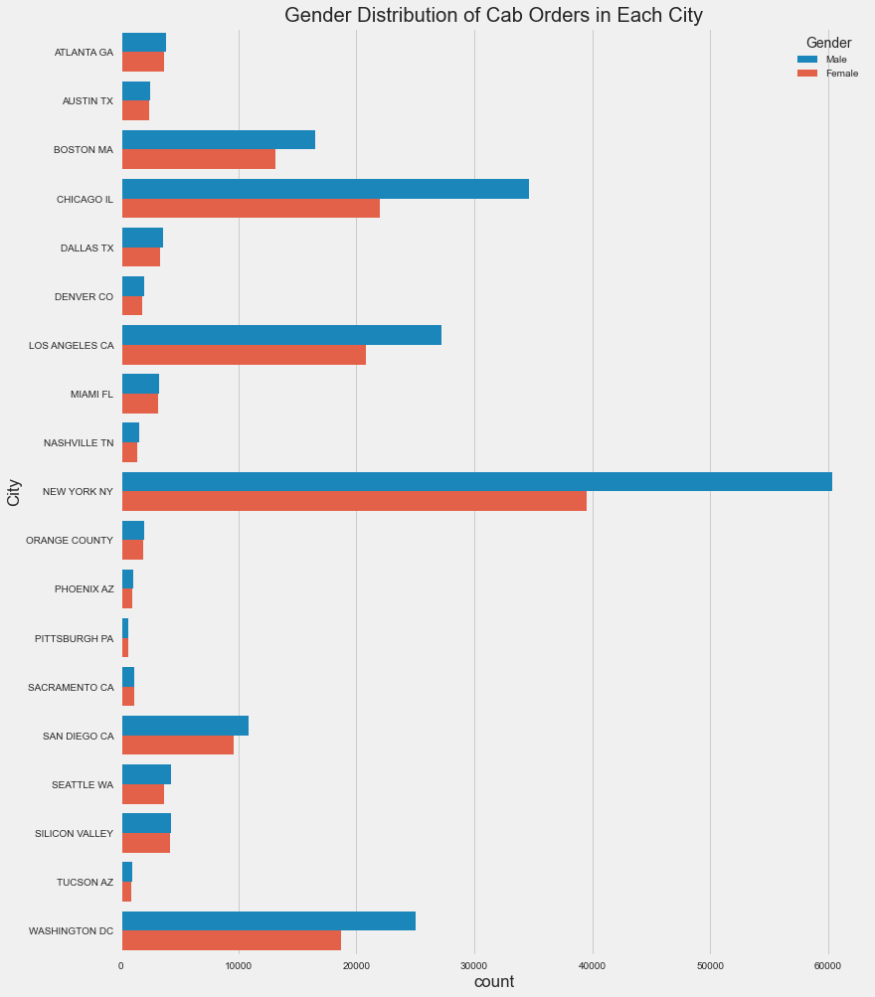
Gender Distribution of Cab Orders in Each City

Slide 18
Profit Analysis
EDA

Slide 19
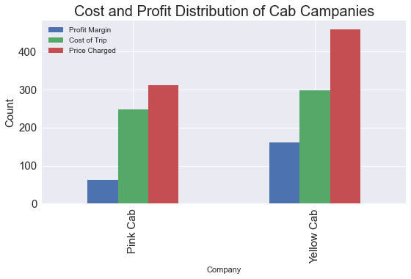
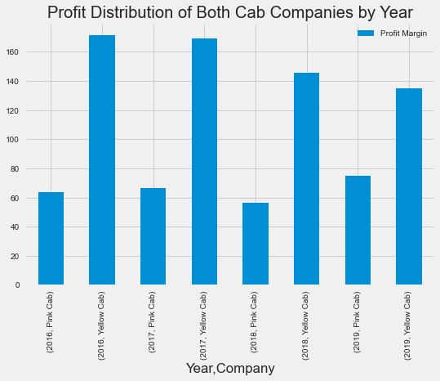
This graph shows the profit margin of Each Cab company per year. We can see that the profit margin of Yellow Cab is more than Pink Cab. However, Yellow Cab company profit was more in year 2016 and 2017 and it has a decreasing trend. Also, Note that Pink Cab company has an increasing profit growth trend.
Profit Analysis

Slide 20
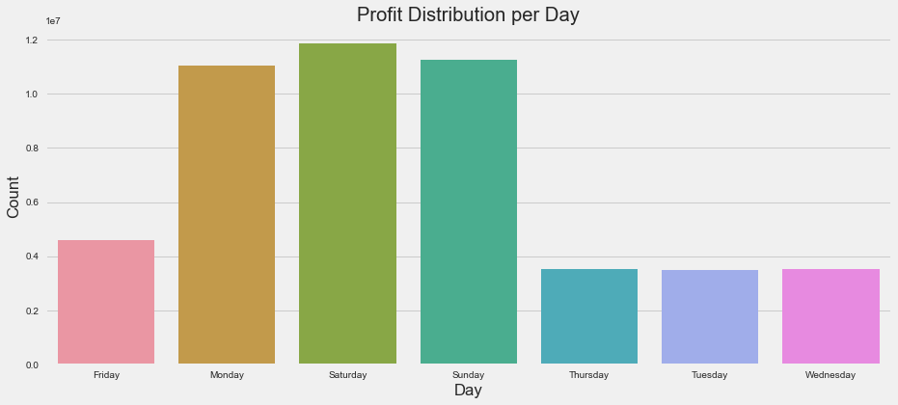
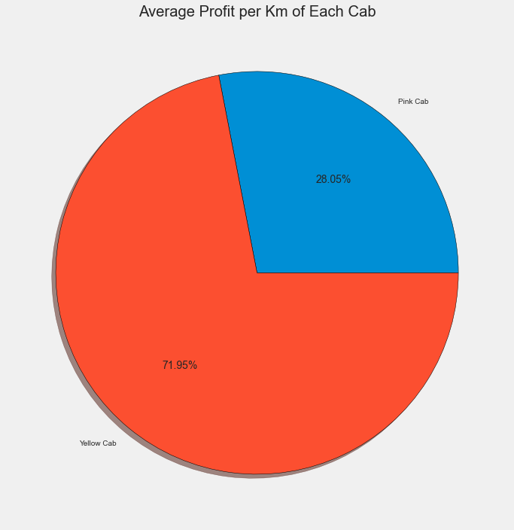
Yellow Cab’s average profit per KM is almost three times the average profit per KM of the Pink cab.
Profit Analysis
This graph shows that on Mondays, Saturdays and Sundays Cab Companies are making more profit.

Slide 21
EDA Results
The Results of the Above EDA are :
Most Users prefer to use Yellow Cab Than Pink Cab
Most Users prefer to pay by Card than Cash.
Most of the Users travel in between 5 to 40 km.
Most of the Users where in between age 20 to 40.
Price charged by Yellow cab is comparatively more than Pink Cab.
Male users prefer to travel by cab more.
New York City has the highest Cab users with 27% followed by Chicago with 16% and Los Angeles with 13%.
Cab was ordered the most in the month of January and December.
Travel by Cab was more in 2017 and 2018.
Yellow Cab is more popular 15 countries including Washington DC, New York NY, Chicago IL, Boston MA. However, Pink Cab is more popular in San Diego CA, Sacramento CA and Nashville TN.
Yellow cab has customer in all age group, and it’s been observed that it’s even popular in 50+ age group as equally as 18-29 age group

Slide 22
Recommendation
We have evaluated both the cab companies on following points and found Yellow cab better than Pink cab:
Profit Analysis : The profit margin of Yellow Cab is more than Pink Cab.
Users Reach : Yellow Cab has more number of users.
Customer Preference : Most Users prefer to use Yellow Cab Than Pink Cab.
Age wise Reach : Yellow cab has customer in all age group, and it’s been observed that it’s even popular in 50+ age group as equally as 18-29 age group.
Average Profit per KM: Yellow Cab’s average profit per KM is almost three times the average profit per KM of the Pink cab.
City wise Reach : Yellow Cab is more popular 15 countries including Washington DC, New York NY, Chicago IL, Boston MA.
Based on above point , we will recommend Yellow cab for investment.

Slide 23
Hypothesis Testing
EDA

Slide 24
Pink Cab
Hypothesis 1:
Is there any difference in Profit with mode of Payment?
Defining Null Hypothesis
H0 : There is no significant difference regarding mode of payment in both cab companies.
Defining Alternate Hypothesis
H1 : There is significant difference regarding mode of payment in both cab companies.
Yellow Cab
We can now say that there is no difference in profit with mode of payment

Slide 25
Pink Cab
Hypothesis 2:
Is there any difference in Profit with Weekend?
Defining Null Hypothesis
H0 : There is no significant difference regarding weekend on Profit, in both cab companies.
Defining Alternate Hypothesis
H1 : There is significant difference regarding weekend on Profit, in both cab companies.
Yellow Cab
We can now say that there is significant difference in profit with Weekend

Slide 26
Thank You
EDA

